Slide 1
CS3220 Processor Design
Spring 2017
Prof. Hyesoon Kim

Slide 2
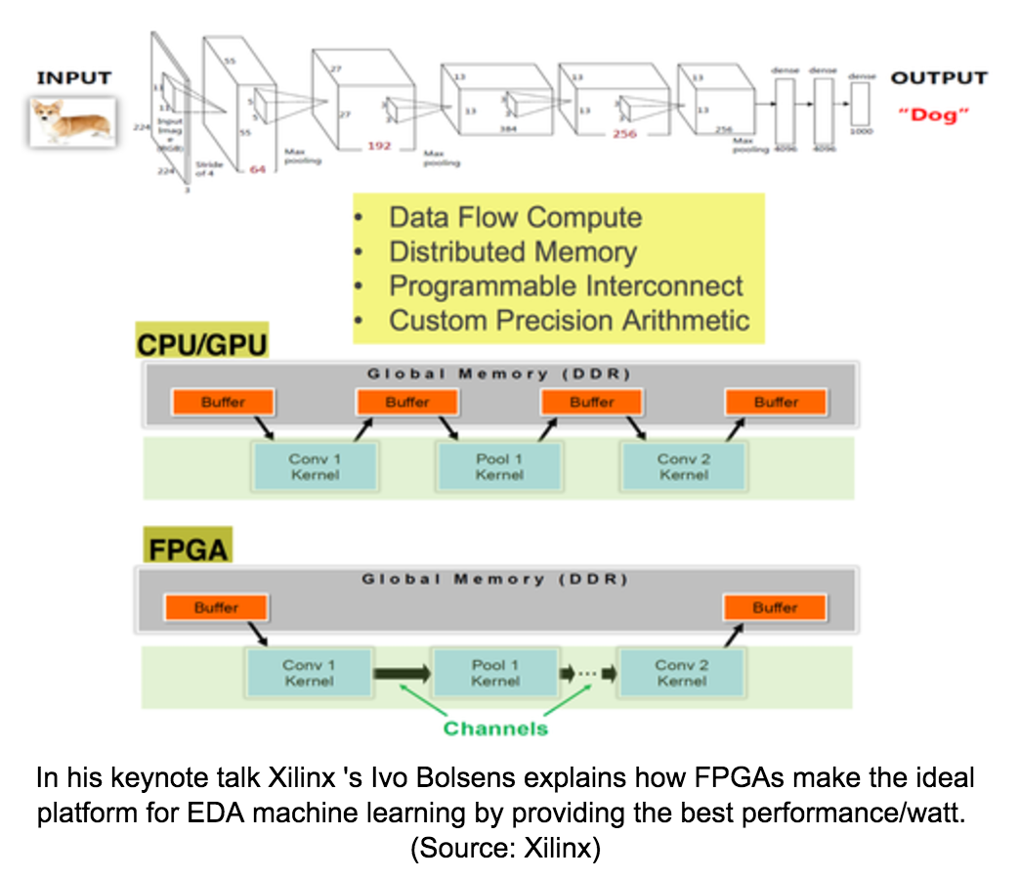
Using FPGA for the AI Chips
This year’s KEYNOTE

Slide 3
Timing optimizations
You are allowed to do timing optimizations by changing PLL
No “negative slack”
Even if your results show the correct output, with a negative slack, you will loose point (5 points)

Slide 4
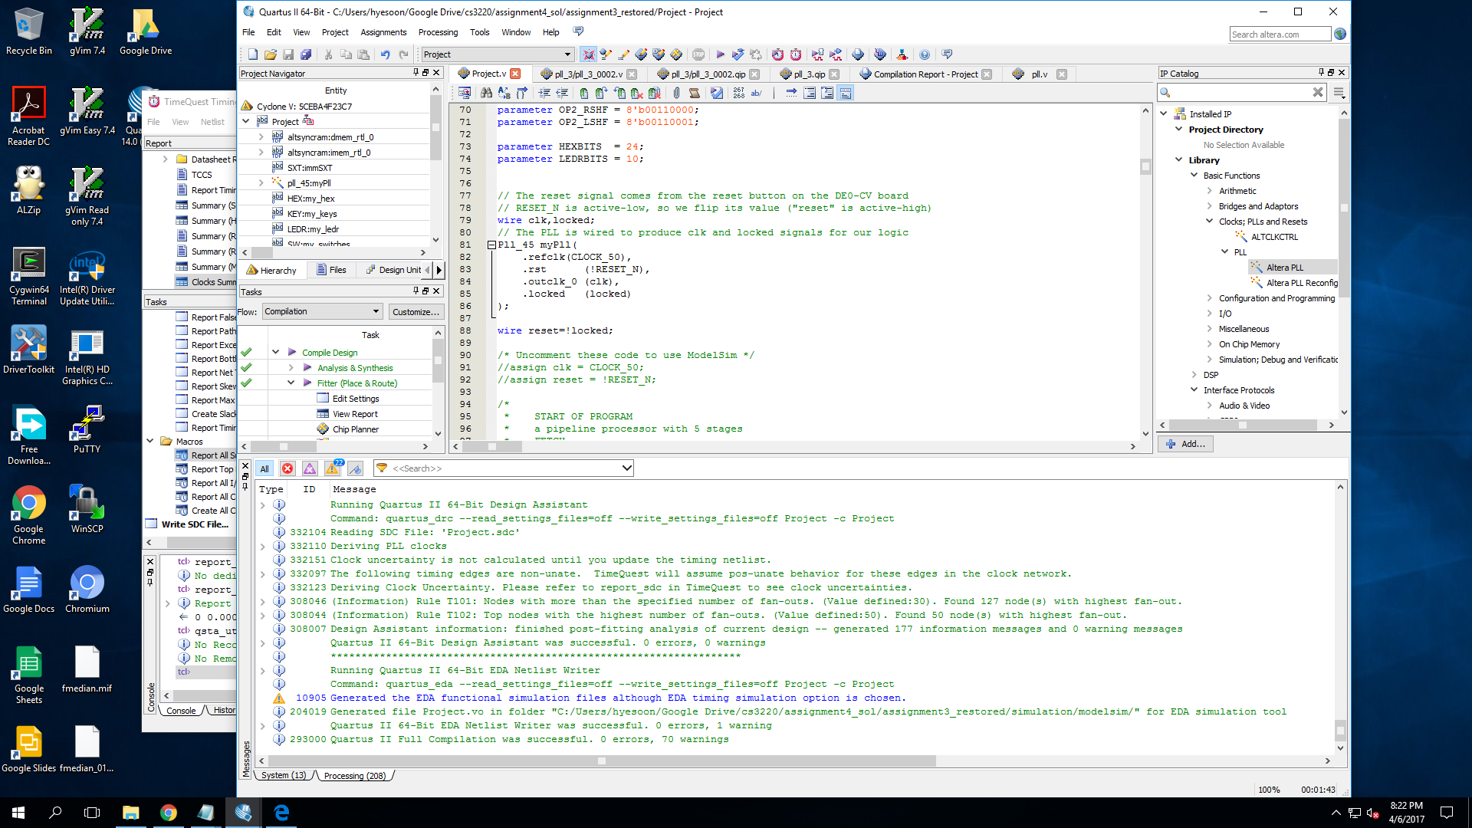
PLL setups
Use IP Core catalog

Slide 5
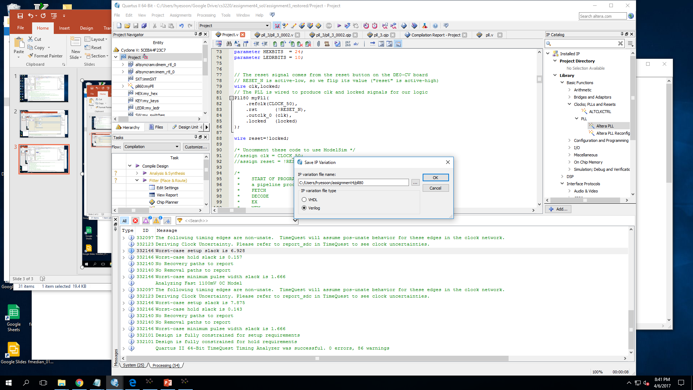
Set filelname → your new pll module name

Slide 6
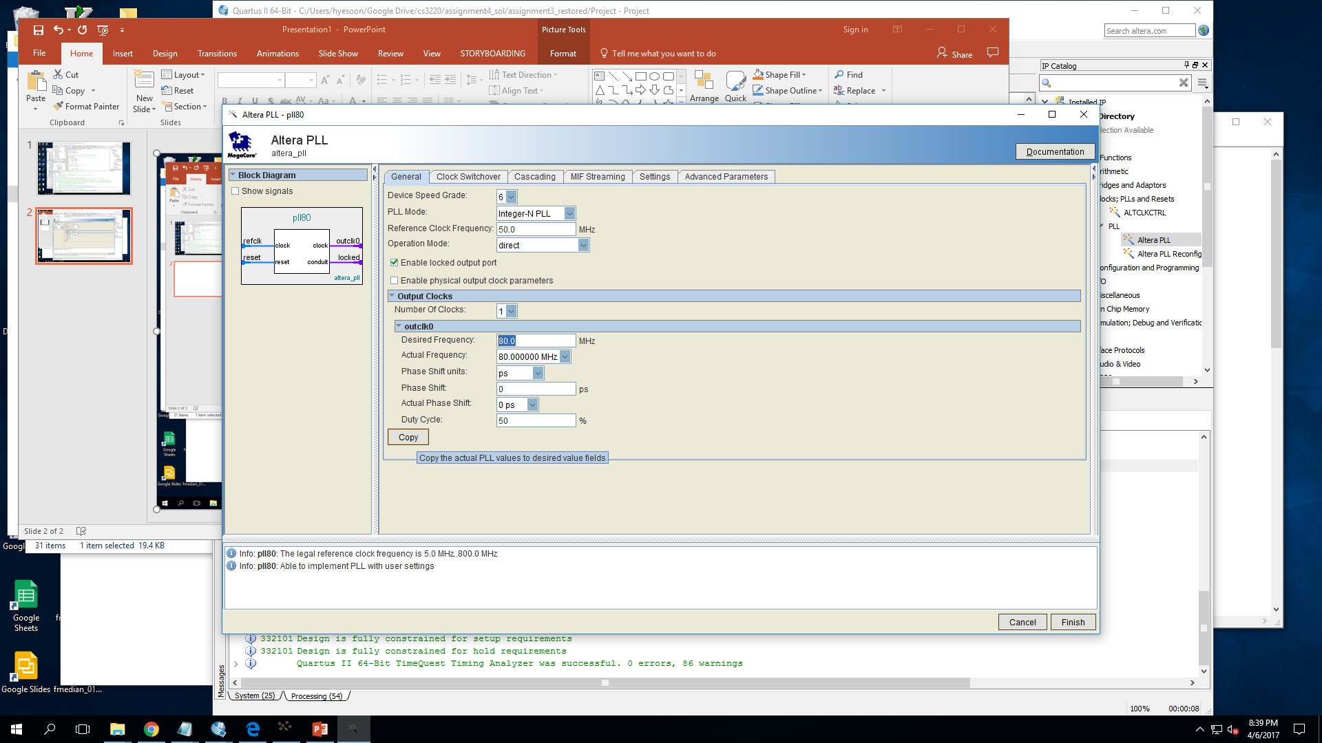
Configure output freq.
You can also control duty cycle!
If you use the both edge..
Reg write & read
Save & Ext
Check the box to include the files into your project directory

Slide 7
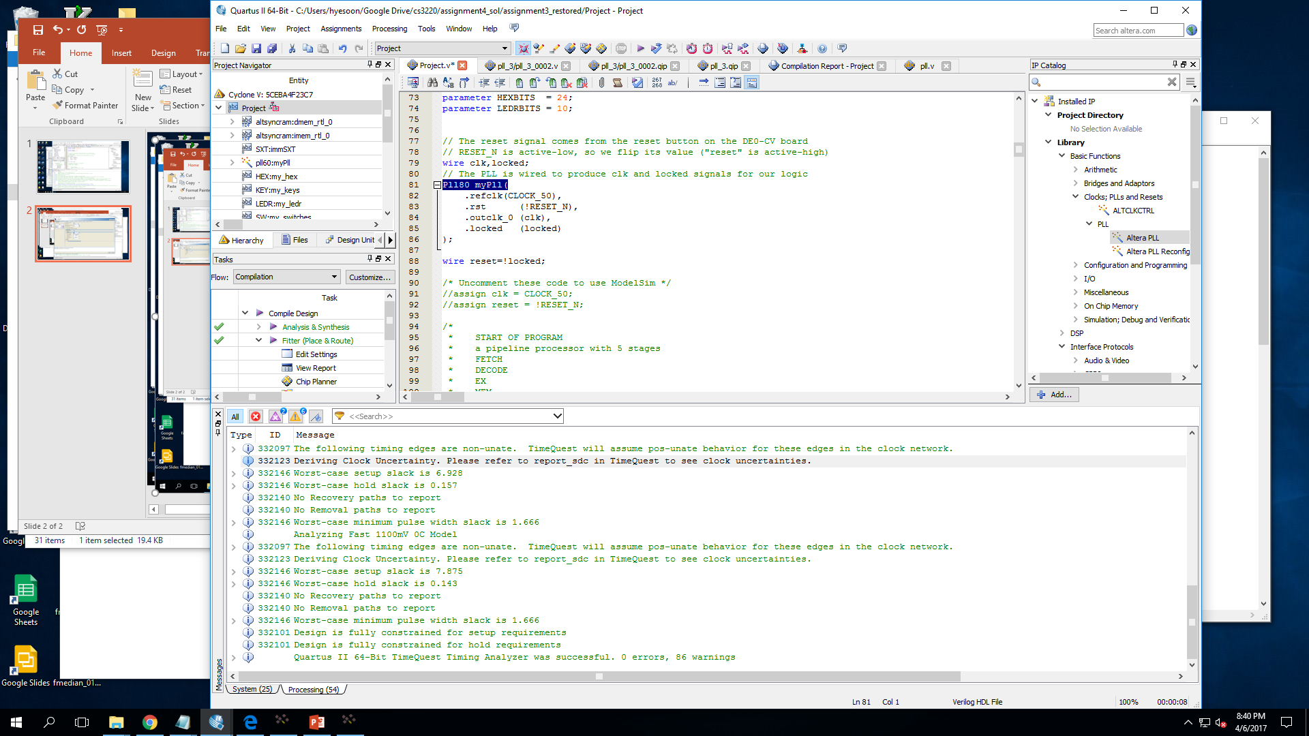
Change pll → your new file name

Slide 8
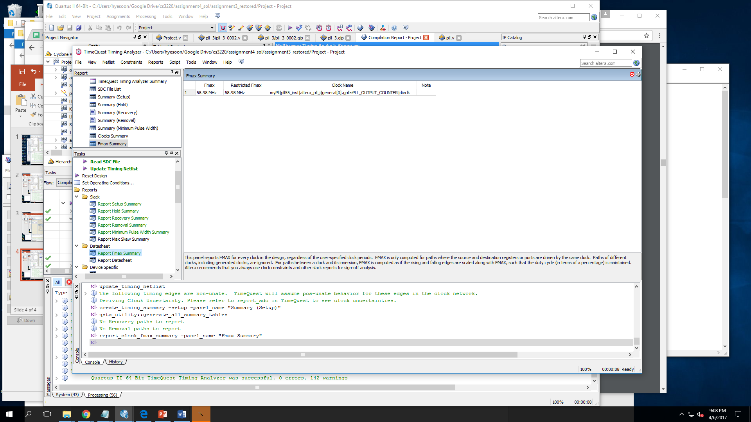
Use TimeQuest to do clock analysis

Slide 9
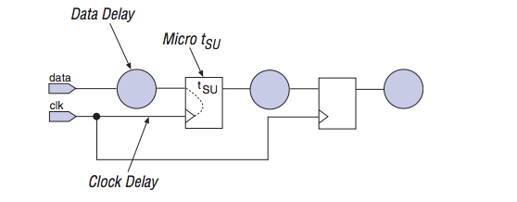
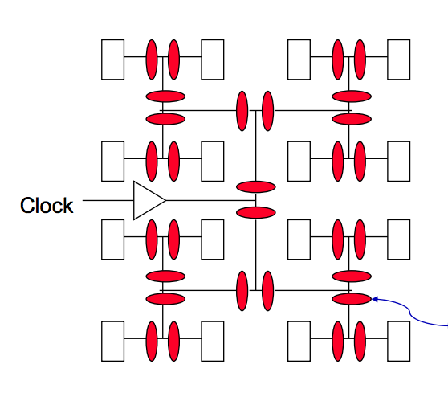
Clock Skew/Clock Delay
clk
Just like data are delayed, clocks can be delayed to.

Slide 10
Review: Setup Time (T_{su})/Hold Time (T_{H})
Setup Time: the amount of time the synchronous input (D) must be stable before the active edge of the clock
Hold Time: the amount of time the synchronous input (D) must be stable after the active edge of the clock
If either is violated correct operation of the FF is not guaranteed
T hold
T setup
CLK
stable

Slide 11
T _{clk->Q} (Clock-to-output delay (t_{co}))
T _{clk->Q} : the amount of time you have to wait after the CLK before the output (Q) is valid
If you try to use the output before this you will get inconsistent results depending on if Q changes
T hold
T setup
CLK
stable
Q Stable
New Q Stable
T clk->Q

Slide 12
F_{MAX}
Pin-to-Pin Delay (T_{PD}):the time required for a signal from an input pin to propagate through combinational logic and appear at an external output pin.
F_{MAX}: Maximum Clock Frequency: the fastest speed w/o timing violation.
Slack : margin whether a timing requirement is met or not
Slack = required clock period - Actual clock period

Slide 13
Caution!
If you change your PLL, you have to adjust the counter for the timer

Slide 14
Writing XMAX.ASM
Writing ASM will take quite a long time than what you think. (>10 hours)
Don’t procrastinate the work.
If your assembler is not robust, your ASM might have bugs which will be very hard to debug with your hardware

Slide 15
Example of checking KEY status
Loopbegin:
LW S0,KCTRL(Zero) ;Load Current key control bits
ANDI S0,S0,1 ; get KCTRL[0] only
ADDI S1,Zero,1 ; S1 = 1’b1;
BNE S0,S1,CheckSwitches ;Skip key check subroutine if not ready
CALL KeySubroutine(Zero) ;jump to the key subroutine since ready bit is 1

Slide 16
KeySubroutine:
LW T1,KDATA(Zero) ;Read current key values
ADDI T0,Zero,1 ; T=
BEQ T1,Zero,IncBNLINK ;KEY[1] has been pressed, so increment blinkspeed
…
Q. Do we clear KCTRL [0] bit? Since we read ready bit?

Slide 17
Set up:
Timer
Display initial HEX value (2)
Setup blankspeed,
Infinite Loop {
Check whether time is passed then call time check loop
Check key is changed
Check sw is changed
Loop back
}

Slide 18
Running out of Registers!!
We don’t have many registers to work with
T0, t1, s0..s0. a0-a2 …
Multiple states to keep track
Blankspeed
State of lights …
You have to store them in a memory location and use LD/SW to change them.

